Slide 1
GPUs and CUDA 2 Memory and Warps
CS121 Parallel Computing
Spring 2021

Slide 2
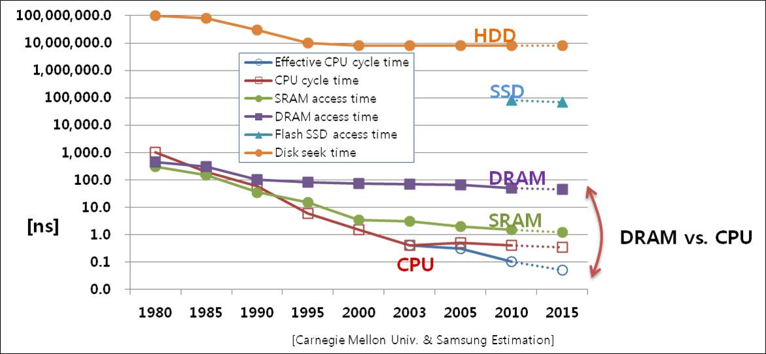
Need for speed
Speed of code determined by amount of computation and memory accesses.
Computation speed has been improving much faster than memory latency and bandwidth.
Today, the main bottleneck is high memory latency and low memory bandwidth relative to CPU.
But processors can access many different types of memory.
Can write fast code if use right memory at right time.

Slide 3
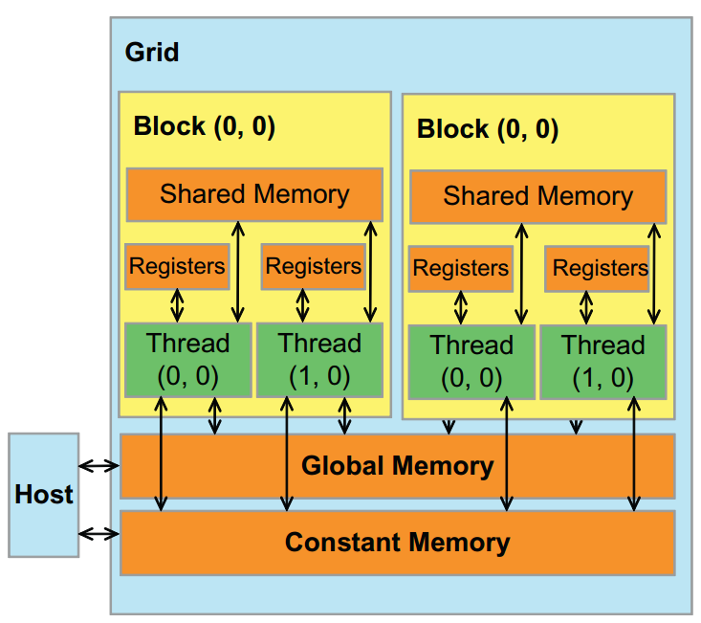
GPU memory organization
GPU has several types of memory.
Different size, latency, bandwidth and scope.
Generally, the larger the size and scope, the slower and less bandwidth.
Registers, shared memory, L1 cache are on-chip, much faster and higher bandwidth than global memory.
L1 cache is controlled by hardware.
In contrast, programmer controls what’s stored in shared memory.
Shared memory size + L1 cache size = 64KB. User configurable.
Type | Size | Latency (cycles) | Bandwidth | Visibility
Global | 1-12 GB | 400-800 | 900 GB/s | grid
Constant | 64KB | cached |  | grid, read-only
Shared | 48KB/16KB per SM | ~20 | 12,000 GB/s | block
L1 cache | 16KB/48KB per SM | ~20 | 12,000 GB/s | block
Registers | 64K per SM | ~1 |  | thread

Slide 4
Global memory latency
Global memory has very high latency.
If each thread waits (blocks) for a global memory operation to finish before doing the next operation, performance is very poor.
Solution is to keep large pool of active threads.
When one thread blocks doing a memory operation, switch to another thread.
“Massive multi-threading” (MMT).
Total throughput high, even though each thread has high latency.
time
time
latency
switch

Slide 5
Global memory latency
Each SM has own scheduler to do thread switching.
Different from device Gigathread scheduler, which allocates thread blocks to SMs.
Each thread’s context (program counter, registers) always maintained in the SM.
SM has ~64K registers to allocate to ~1000 threads in a thread block.
Very fast, “zero overhead” thread switching.
SM scheduler has “scoreboard” to keep track of which threads assigned to the SM are blocked / unblocked.
Keeps picking unblocked threads to run.
Only effective if SM has many threads, so that there always exists some unblocked threads.
This is why SM can run ~1000 threads, though it only has ~30 cores.
For high performance need many threads per SM.
High “occupancy”.

Slide 6
Global memory bandwidth
Massive multithreading not enough for performance.
Only addresses latency.
But doesn’t help with other bottleneck, bandwidth.
GPU’s computing power is much higher than its global memory bandwidth.
Ex Compute:1.5 TFLOPS. Bandwidth: 200 GB/s.
Recall matrix multiplication
Pvalue += M[Row*Width+k] * N[k*Width+Col]
6 floating point ops (+, *) for 2 memory ops (read M and N).
Compute to global memory access (CGMA) ratio 3:1.
200 GB/s = 50G floating point vals / sec ⇒ 150 GFLOPS.
1/10 of theoretical peak!

Slide 7
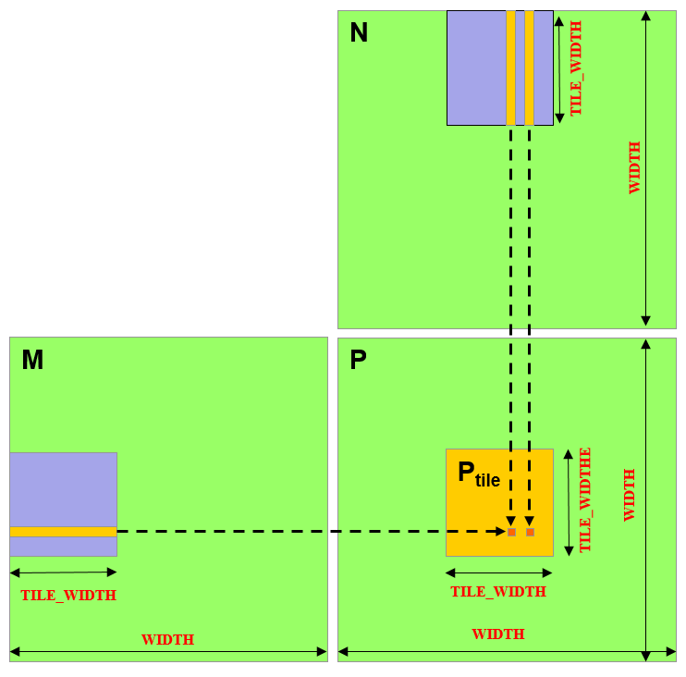
Exploiting data reuse
__global__ void MatrixMulKernel(float* d_M, float* d_N, float* d_P, int Width) {
int Row = blockIdx.y*blockDim.y+threadIdx.y;
int Col = blockIdx.x*blockDim.x+threadIdx.x;
if ((Row < Width) && (Col < Width)) {
float Pvalue = 0;
for (int k = 0; k < Width; ++k)
Pvalue += d_M[Row*Width+k] * d_N[k*Width+Col];
d_P[Row*Width+Col] = Pvalue; } }
P_{tile} contains a block of TILE_WIDTH² threads.
Every thread loads all data it needs by itself.
TILE_WIDTH² threads in P_{tile} each loads 2*TILE_WIDTH data ⇒ 2*TILE_WIDTH³ global memory reads.
But notice all threads in P_{tile} need data from purple tiles.
Purple data can be reused!
Threads in P_{tile} cooperate to load purple tiles, eliminating redundant global memory reads.
Only 2*TILE_WIDTH² global memory reads in total. A factor of TILE_WIDTH less!

Slide 8
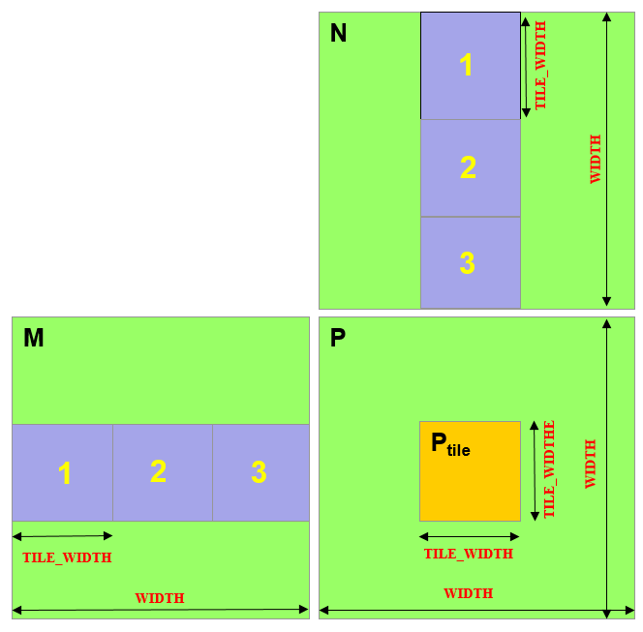
Shared memory and tiled MM
Tiled MM is a memory efficient method of performing matrix multiplication using shared memory.
Break M, N into tiles and multiply tile by tile.
Work in phases.
Exploit data reuse in each phase.
# phases = WIDTH / TILE_WIDTH
In phase i, threads in P_{tile} cooperatively load i^{th} tile from M, N in global memory into shared memory.
Then each thread reads a row and column of data from shared memory.
After all threads finished with the tiles, next two tiles loaded, overwriting current ones.

Slide 9
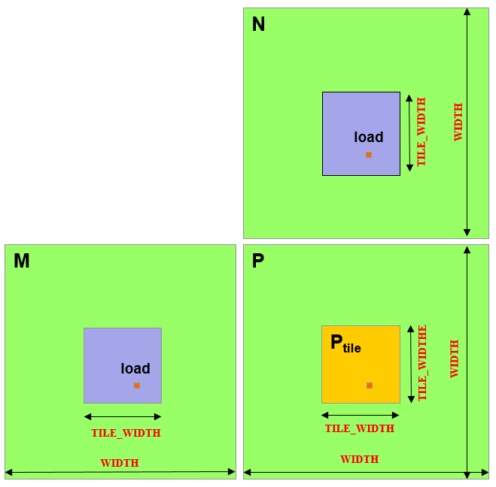
Tiled matrix multiplication
__global__ void MatrixMulKernel(float* d_M, float* d_N, float* d_P, int Width) {
// Allocate space for M and N block in shared memory
// Thread in block (bx, by) works on (bx, by)’th P_{tile}
// Thread with ID (tx, ty) works on element (tx, ty) in its P_{tile}
// Loop over the M and N tiles required to compute the P element
for (int m = 0; m < WIDTH/TILE_WIDTH; m++) {
// Load one element from M and N into shared memory
// How do we calculate which elements to load?
// Wait till all threads finished loading from M and N
// Compute dot product from shared memory M and N tiles
// Wait till all threads in block finish using M and N tiles
}
// Write value of P element back to global memory
}

Slide 10
Tiled matrix multiplication
__global__ void MatrixMulKernel(float* d_M, float* d_N, float* d_P, int Width) {
__shared__ float ds_M[TILE_WIDTH][TILE_WIDTH];
__shared__ float ds_N[TILE_WIDTH][TILE_WIDTH];
int bx = blockIdx.x; int by = blockIdx.y;
int tx = threadIdx.x; int ty = threadIdx.y;
// Thread identifies row and column of P element to work on
int Row = by * TILE_WIDTH + ty;
int Col = bx * TILE_WIDTH + tx;
float Pvalue = 0;
// Loop over the M and N tiles required to compute the P element
for (int m = 0; m < WIDTH/TILE_WIDTH; m++) {
// Collaboratively load M and N tiles into shared memory
ds_M[ty][tx] = d_M[Row*WIDTH + m*TILE_WIDTH+tx];
ds_N[ty][tx] = d_N[Col+(m*TILE_WIDTH+ty)*WIDTH];
// Wait till all threads finished loading tiles
__syncthreads();
// Compute dot product from tiles
for (int k = 0; k < TILE_WIDTH; ++k)
Pvalue += ds_M[ty][k] * ds_N[k][tx];
__synchthreads();
}
d_P[Row*Width+Col] = Pvalue;
}

Slide 11
Shared memory and tiled MM
Decreases total number of reads from global memory compared to naive algorithm.
Consider an nxn matrix with mxm blocks.
Naive algorithm
n² elements each require 2n global memory reads. 2n³ total.
Shared memory algorithm
(n/m)² blocks in total.
Each block does n/m phases.
In each phase, block does 2m² reads from global memory.
Total (n/m)²*(n/m)*2m² = 2n³/m accesses.
A factor of m less!
Doesn’t decrease overall number of memory accesses.
Threads do 2n³ reads to shared memory instead of global memory.
But get much better performance, because shared memory bandwidth is 10X global memory bandwidth.

Slide 12
Tiled matrix multiply performance
With 16x16 tiles, decrease global memory usage by factor of 16.
Can get (200GB/4B)*(3 FLOP / 1B)*16 = 2400 GFLOPS, compared to 150 GFLOPS from before!
Each thread block uses 16 x 16 x 4B x (2 matrices) = 2KB of shared memory.
Even if only 16KB shared memory, can still run 8 blocks per SM, which is enough to achieve full occupancy.
Each block has 256 threads, so 6 blocks enough to saturate SM with 1536 thread capacity.
If use 32x32 tiles, then 1024 threads per tile / thread block, so only one thread block per SM.
Only 2/3 occupancy if SM can run 1536 threads.
Note the tradeoff between improving bandwidth and occupancy.

Slide 13
Effective use of shared memory
General strategy is to find reused data and load it into fast, high bandwidth memory.
Very effective in practice.
Same principle as caches, except that programmer controls what’s in shared memory.
Data reuse is also called temporal locality.
Using shared memory is sometimes hard, since it’s so small.
48KB shared mem / SM, vs. 6 GB global mem.
On a CPU, 32KB L1 cache vs 8GB main mem.
Designing algorithms with high temporal locality is one of main techniques for getting fast code.

Slide 14
CUDA Variable Type Qualifiers
Variable declaration | Memory | Scope | Lifetime
int LocalVar; | register | thread | thread
__device__ __shared__ int SharedVar; | shared | block | block
__device__ int GlobalVar; | global | grid | application
__device__ __constant__ int ConstantVar; | constant | grid | application
__device__ is optional when used with __shared__, or __constant__.
Automatic variables without any qualifier reside in a register.
Except per-thread arrays, which reside in global memory.

Slide 15
Synchronization
In algorithms up to now, threads mostly worked independently.
E.g. it’s ok if say thread 1 took 3 steps but thread 2 took 7.
Sometimes threads need to coordinate. I.e. they must all finish some step before any thread can go on to next step.
Ex In MM, threads must finish loading M, N tiles into shared mem before any thread can start its dot product.
Threads within a block can synchronize using __syncthreads().
Scheduler ensures a thread reaching __syncthreads() statement blocks until all threads in block also reach that __syncthreads().
This is a barrier synchronization.

Slide 16
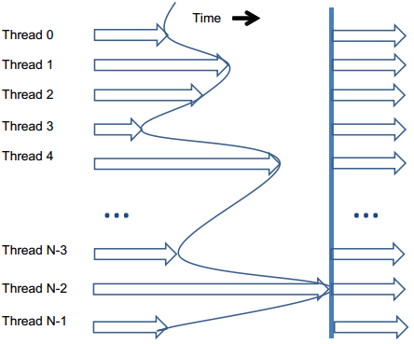
Synchronization
Must be careful with synchronization.
Ex If code has __syncthreads() but some thread in block goes into infinite loop, block will never finish!
Ex If __syncthreads() occurs in if block, then all threads must go through the if, or none do. Otherwise block never finishes.
Ex If __syncthreads() occurs in both branches of if-then-else code block, all threads must go through same branch, or block never finishes.
__syncthreads() can also cause wasted work. Threads arriving earlier at the barrier wait for later threads.
Decreases number of schedulable threads. May hurt latency hiding.
Avoid synchronization if possible.

Slide 17
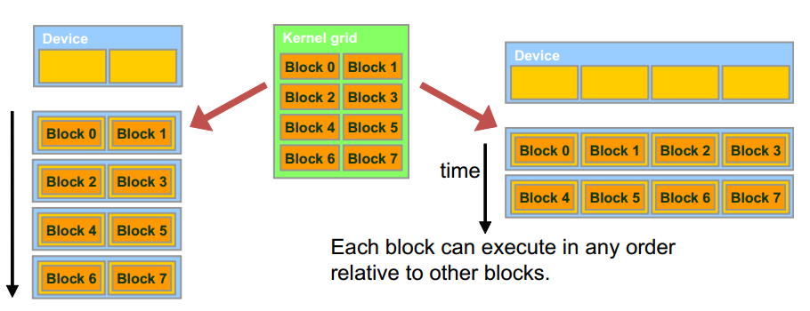
Synchronization
Threads in different blocks can’t synchronize.
This allows blocks to execute in any order, and scale transparently to GPUs with more SMs.
Downside is if need inter-block synchronization, must wait till all blocks in kernel finish, then start a new kernel.

Slide 18
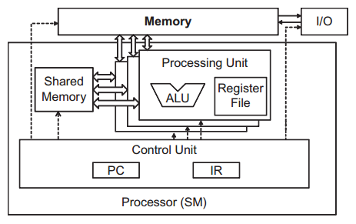
Thread warps
An SM contains one or more SIMD (single instruction multiple data) processors.
Each SIMD processor contains multiple cores that run the same command on different data.
The unit of “SIMDness” is a warp of 32 threads.
An entire warp of threads runs at a time.
A thread block is divided into warps with consecutive threadIdx.x values.
Execution is fast when entire warp “does the same thing”.
Different warps can do different things without performance loss.
It’s much slower when there’s non-coalesced memory accesses, control flow divergence or bank conflicts.

Slide 19
Memory coalescing
Global memory divided into segments of 128 B (= 32 floats).
Suppose SM executes a warp of 32 threads all executing a SIMD instruction reading from global memory.
If all 32 locations being read lie in one segment, hardware detects this and only transfers one segment (128 B) from global memory to SM.
Access is coalesced.
If locations lie in k different segments, k*128 B are transferred.
Access is uncoalesced.
In worst case, transfer 32*128 B = 4KB to read 32 floats!
Huge waste of limited global memory bandwidth.
For good performance, make global memory accesses as coalesced as possible.

Slide 20
Coalescing example
matrix
layout in memory
Say we have 4x4 matrix, stored in row major format.
Suppose segments are 4 elements wide.
I.e. can transfer 4 consecutive elements in one step.
We have warp of 4 threads, and want to iterate through matrix either row by row, or column by column.

Slide 21
Coalescing example
1 | 1 | 1 | 1
2 | 2 | 2 | 2
3 | 3 | 3 | 3
4 | 4 | 4 | 4
When iterating by row, we naturally map one thread to each column.
Need 4 iterations in total.
Numbers show locations accessed each iteration.
Locations all consecutive. All iterations coalesced.

Slide 22
Coalescing example
1 | 2 | 3 | 4
1 | 2 | 3 | 4
1 | 2 | 3 | 4
1 | 2 | 3 | 4
When iterating by column, map one thread per row.
In iteration 1, access locations 0,4,8,12.
In iteration 2, access locations 1,5,9,13. Etc.
Each iteration accesses nonconsecutive locations.
All accesses noncoalesced.

Slide 23
Improving coalescing
global memory
copy
shared memory
shared memory
Only global memory has bandwidth penalty for noncoalesced accesses.
Shared memory has much smaller penalty for scattered accesses.
To improve coalescing, first do coalesced read from global to shared memory. Then make scattered accesses to shared memory.
Ex To read matrix by column, first read it by row and copy to matrix in shared memory. Then read shared memory matrix by column.
Once again shows flexibility of shared memory vs global memory.

Slide 24
Warp divergence
Since SM is SIMD, efficient when all threads run same instruction.
SM finishes a warp in one pass.
But if code has branches, threads can run different instructions.
if (threadIdx.x % 3 == 0) i += 1;
else if (threadIdx.x % 3 == 1) i -= 1;
else i *= 2;
Called warp divergence.
If threads have k branches, SM takes k passes to run warp.
In each pass, runs all threads of one branch, which all run same instruction.
In worst case, SM takes 32 passes to run one warp!

Slide 25
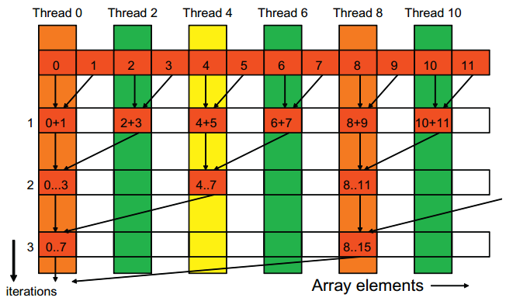
Divergence example
Reduction produces single number from array of numbers.
Ex Returns sum, max, or min of array.
Very commonly used operation.
Can be computed in parallel using reduction tree.
With n values and n threads, do O(n) additions, take O(log n) iterations.

Slide 26
Divergence example
int t = threadId.x;
for (int stride = 1; stride < blockDim.x; stride *= 2) {
__syncthreads();
if (t % (2*stride) == 0)
partialSum[t] += partialSum[t+stride];
}
Number of threads working halves every iteration.
Each working thread adds value from stride away into its location in output array.
stride=1 in iteration 1, then 2, 4, 8, etc.
__syncthreads() ensures all values from one iteration complete before computing next iteration.

Slide 27
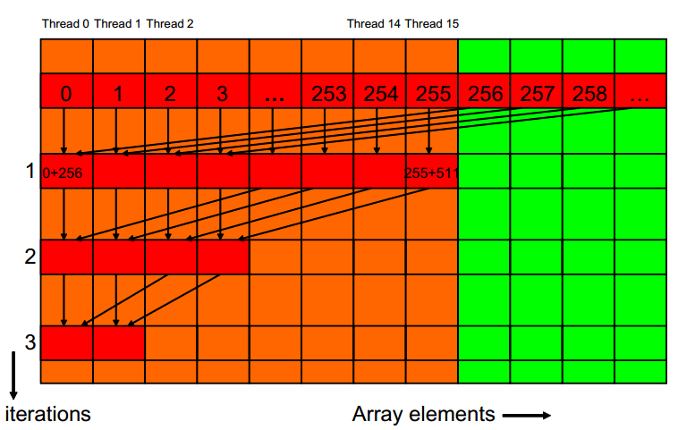
Reducing divergence
Each iteration has 2 branches, the threads with (t % (2*stride) == 0), and the other threads.
Each iteration takes 2 passes to complete.
Can modify algorithm to decrease amount of divergence.
Still tree based, but first add values from far away.
Iter 1: first 256 threads add value from 256 away.
Iter 2: first 128 threads add value from 128 away.
Iter 3: first 64 threads add value from 64 away. Etc.
Work, time complexity same as before.

Slide 28
Reducing divergence
int t = threadId.x;
for (int stride = blockDim.x; stride > 1; stride /= 2) {
__syncthreads();
if (t < stride)
partialSum[t] += partialSum[t+stride];
}
Why is divergence reduced?
In first iteration, first 256 threads = 8 warps all do if, last 8 warps all don’t.
In second iteration, first 128 threads = 4 warps do if, last 12 don’t.
No divergence till 5th iteration.
From 5th iteration on, 16, 8, 4, 2 threads from first warp do if.
8 iterations, only 4 have divergence.
Can you get rid of the 4 iterations with divergence?

Slide 29
Bank conflicts
Shared memory is arranged in banks.
A bank stores a set of 4B data.
Allows parallel accesses. Threads can access different banks at same time.
If n banks, then address x is stored in bank x % n.
Current GPUs have 32 banks.
If threads in a warp access different banks, completes in one pass.
If k > 1 threads access different addresses in same bank, get k-way bank conflict.
Accesses serialize, takes k passes to complete accesses.
Unless all threads access same value, which then gets broadcast in one pass.
Different warps don’t have bank conflicts.
bank 0
0 | 4 | 8 | 12 | 16
1 | 5 | 9 | 13 | 17
2 | 6 | 10 | 14 | 18
3 | 7 | 11 | 15 | 19
bank 1
bank 2
bank 3

Slide 30
Bank conflict example
Suppose 4 banks, warp size = 4 and block size = 4.
Want each thread to load two values from global memory into shared memory.
If thread loads consecutive locations, 2 way bank conflict.
If thread loads locations block size apart, no bank conflicts!
int tid = threadIdx.x;
shared[2*tid] = global[2*tid];
shared[2*tid + 1] = global[2*tid+1];
int tid = threadIdx.x;
shared[tid] = global[tid];
shared[tid + blockDim.x] = global[tid + blockDim.x];
thread 0
0 | 4 | 8 | 12 | 16
1 | 5 | 9 | 13 | 17
2 | 6 | 10 | 14 | 18
3 | 7 | 11 | 15 | 19
thread 0
0 | 4 | 8 | 12 | 16
1 | 5 | 9 | 13 | 17
2 | 6 | 10 | 14 | 18
3 | 7 | 11 | 15 | 19
thread 1
thread 1
thread 2
thread 2
thread 3
thread 3

